Slide 1
CSC 111 LECTURE 3
BASIC COMPONENTS OF COMPUTER SYSTEM (SOFTWARE)

Slide 2
Programs and Programming Languages
A program is a collection of instructions written in the language of the computer in strictly defined order.
2 Types of programming languages
Low-Level Languages (LLL)
High-Level Languages (HLL)

Slide 3
Low-Level Languages (LLL)
These are also called machine languages.
They consists of only binary digits 0 & 1.
computers are coded using 0 & 1,
so it is the language the digital computer uses to execute programs but difficult for the programmer to write.
Advantage
A program written in machine language truly represents how data is manipulated by the computer.
Disadvantages / Drawbacks
It is machine dependent
It is very tedious to write programs in machine language
It is very difficult to find errors

Slide 4
LLL continue
Assembly Language:
replaces binary codes in machine languages with symbols / mnemonics.
assembler is then used to translate code into machine code before execution.
developed to reduce the burden of the machine language
by representing the binary numbers with symbols.
Each assembler is written for a specific processor code or hardware
translates one assembly instruction into one machine code instruction.
The assembly language instruction input
source code and
The machine code output
the object code.

Slide 5
High-Level Languages (HLL)
Are developed for the benefit of programmers
easier to understand.
Many of them have been designed to assist in the solution of specific types of application eg
COBOL (Common Business Oriented Language) developed for business applications
FORTRAN (FORmular TRANslation) developed for scientific applications
BASIC (Beginners All-purpose Symbolic Instruction Code) developed for general use and education.
HLL
consists of statements
may be complex arithmetic calculations or logical comparisons.
They are easier to write, test and maintain.
It is also easy to correct if errors are found.
The statements are similar to instructions using the English Language.
A high-level language program (the source code) can be translated into machine code (the object code) by using either a compiler or an interpreter.

Slide 6
Translators
Translators:
are programs that translate programming language code (source code) to machine language code (object code) .
3 Categories of translators
Compilers:
softwares that translate high-level programming language code to machine code.
The significance of a compiler is to convert the whole of a program into machine code and store the compiled form.
All high-level languages have their own compilers eg FORTRAN, PASCAL, C++ etc

Slide 7
Translators (cont.)
Interpreters:
translators which transform programs written in high-level language to machine code.
The converted form of the source code is not stored and each line is translated and executed one at a time eg BASIC
Assemblers:
programs which translate the source program in assembly language programs, into machine code called an object program.

Slide 8
Software
Software:
collection of related programs that are chained together in function and operation.
Classification of Software
Application Software
System Software
Application Software: this instructs the computer to perform those procedures necessary to get some job done.
Types
Spreadsheets eg Microsoft Excel
Word processing eg Microsoft access
Graphics eg PowerPoint and Corel Draw
Database eg DBASE and Desktop Publishing
Accounting packages.

Slide 9
Classification of Software
System Software: group of programs that control the performance and function of the computer system. They are classified into
Database Management systems (DBMS)
Utility Systems
Translators
Monitors
Operating Systems

Slide 10
System Software
Database Management Systems (DBMS): these are group of programs that take care of allocating storage positions to other programs running in the computer system.
They define, create and maintain a database.
DBMS is a combination of 5 components namely
Hardware – physical computer system that allows access to data.
Software – actual program that allow users to access, maintain and update data.
Data – data in a database are stored physically on the storage device.
users – made up of end-users (humans who access the database directly to get information) and application programs.
Procedures – set of rules that should be clearly defined and followed by users of the database.

Slide 11
System Software
Utility Systems:
Designed to analyze, configure, optimize or maintain a computer
Focus on how computer infrastructure (h/w, os etc) operates
Antivirus, backup s/w etc
Monitors:
Program design to track and record computer activities
E.g. keyloggers, system surveillance pro etc.

Slide 12
System Software
Translators: these are programs that translate programming language code (source programs) to machine language code (object program) in order to be executed by the computer. It has 3 categories
(a) Compilers
(b) Interpreters
(c) Assemblers.

Slide 13
System Software
Operating Systems:
layer of software which acts as an interface between the user and the overall hardware.
It can also be defined as a program or sets of programs that facilitates the execution of other programs.
2 Major design goals of an Operating System
Efficient use of hardware
Ease of use of resources

Slide 14
Evolution of Operating Systems
Batch Operating Systems:
designed to control mainframe computers.
Each program to be executed was called a job.
Ensured that all of the computer's resources were transferred from one job to the next.
Time Sharing Systems:
Resources shared between different jobs,
each job being allocated a portion of time to use a resource.
This improved the efficiency of the system, however they required a more complex operating system.
The operating system now had to do Scheduling
allocating resources to different programs and deciding which program should use which resource and when.
E.g. windows etc.

Slide 15
Evolution of OS
Parallel Systems:
these are multiple CPUs on the same machine.
Each CPU can be used to serve one program or a part of a program
many tasks can be accomplished in parallel.
Distributed Systems:
Jobs usually done on one computer shared between computers that may be thousands of miles apart.
A program can be run partially on one computer and partially on another if they are connected through an internetwork such as the internet.
Resources can be distributed,
which means a program may need and be able to get access to files, printers etc located in different parts of the world.

Slide 16
Application Software
Application software consists of programs designed to make users more productive and/or assist with personal tasks
To make business activities more efficient
To assist with graphics and multimedia projects
To support home, personal, and educational tasks
To facilitate communications
Page 142

Slide 17
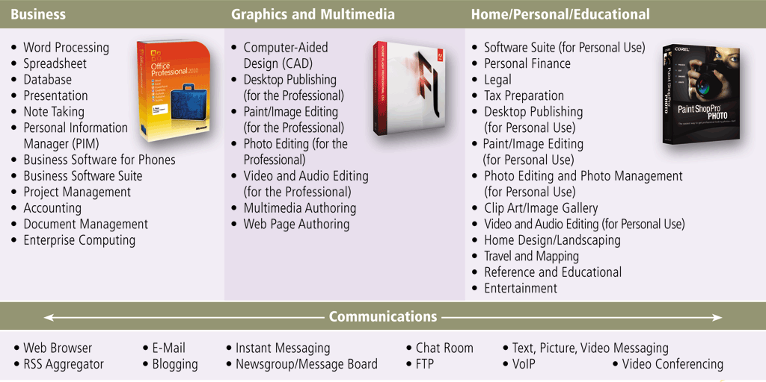
Application Software
Page 142
Figure 3-1

Slide 18
Application Software
Available in a variety of forms:
Packaged software
Custom software
Web application
Open source software
Shareware
Freeware
Public-domain software
Pages 142 – 143

Slide 19
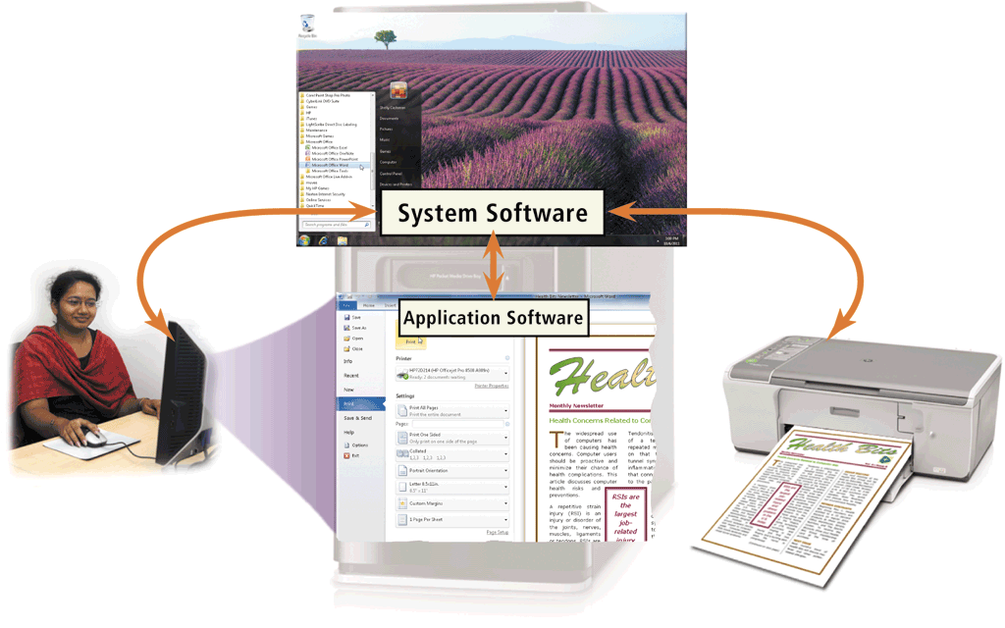
Application Software
System software serves as the interface between the user, the application software, and the computer’s hardware
Utility programs
Page 143
Figure 3-2

Slide 20
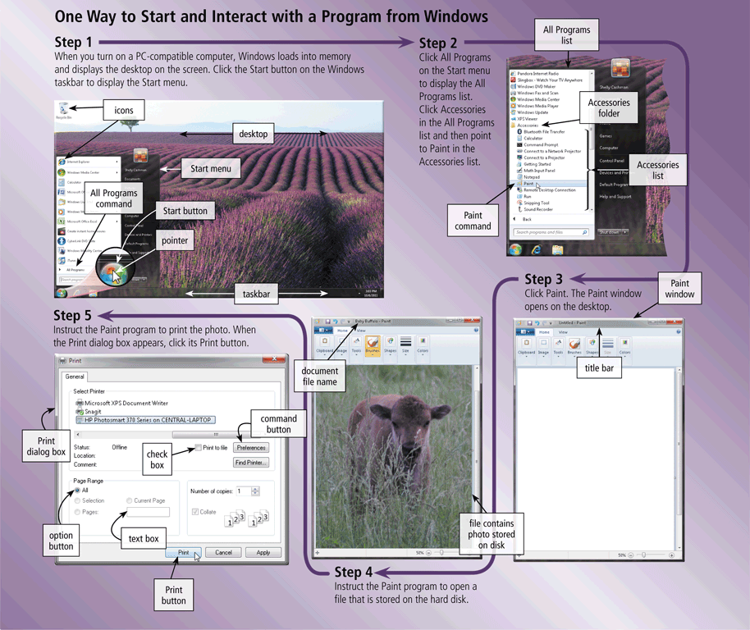
Application Software
Page 145
Figure 3-3

Slide 21
Business Software
Business software is application software that assists people while performing business activities
Word Processing
Spreadsheet
Database
Presentation
Note Taking
Personal Information Manager
Business Software for Phones
Business Software Suites
Project Management
Accounting
Document Management
Enterprise Computing Software
Page 146

Slide 22
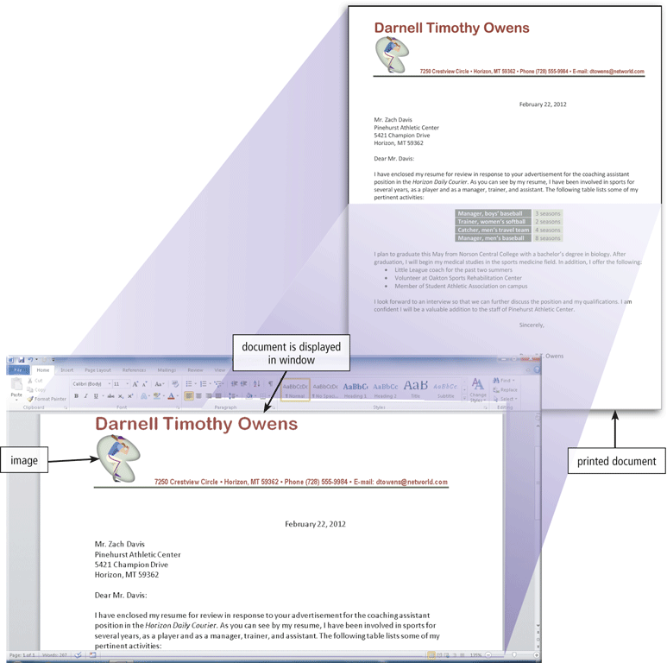
Business Software
Word processing software allows users to create and manipulate documents
Clip art is a collection of electronic drawings, photos, and other images
Page 147
Figure 3-5

Slide 23
Business Software
Additional word processing features include
AutoCorrect
AutoFormat
Collaboration
Columns
Grammar Checker
Ink Input
Macros
Mail Merge
Reading Layout
Research
Search and Replace
Smart Tags
Tables
Templates
Thesaurus
Tracking Changes
Voice Recognition
Web Page Development
Page 148
Figure 3-6

Slide 24
Business Software
Developing a document
Create a document
Enter text and numbers
Edit a document
Make changes to existing content
Format a document
Change appearance
Insert images
Perform other tasks
Inserting, deleting, cutting, copying, and pasting
Font
Font size
Page 149

Slide 25
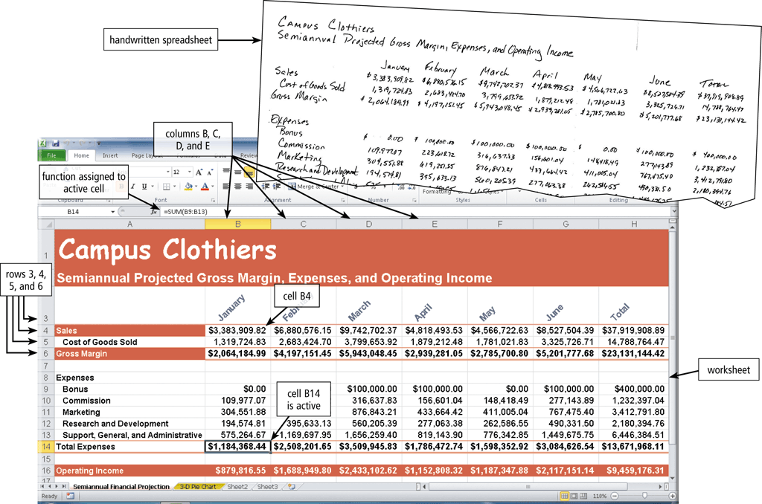
Business Software
Spreadsheet software allows users to organize data in rows and columns and perform calculations
Pages 150 - 151
Figure 3-8

Slide 26
Business Software
A function is a predefined formula that performs common calculations
FV
NPV
PMT
PV
RATE
DATE
NOW
TIME
ABS
INT
LN
LOG
ROUND
SQRT
SUM
AVERAGE
COUNT
MAX
MIN
STDEV
IF
Page 152
Figure 3-9

Slide 27
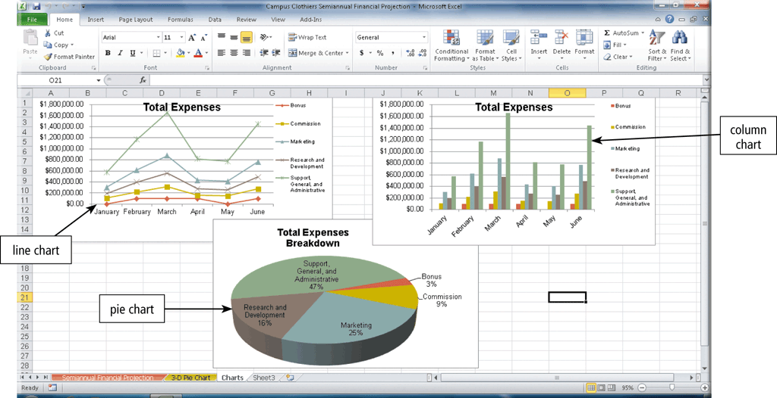
Business Software
Charting depicts data in a spreadsheet in graphical form
Pages 152 – 153
Figure 3-10

Slide 28
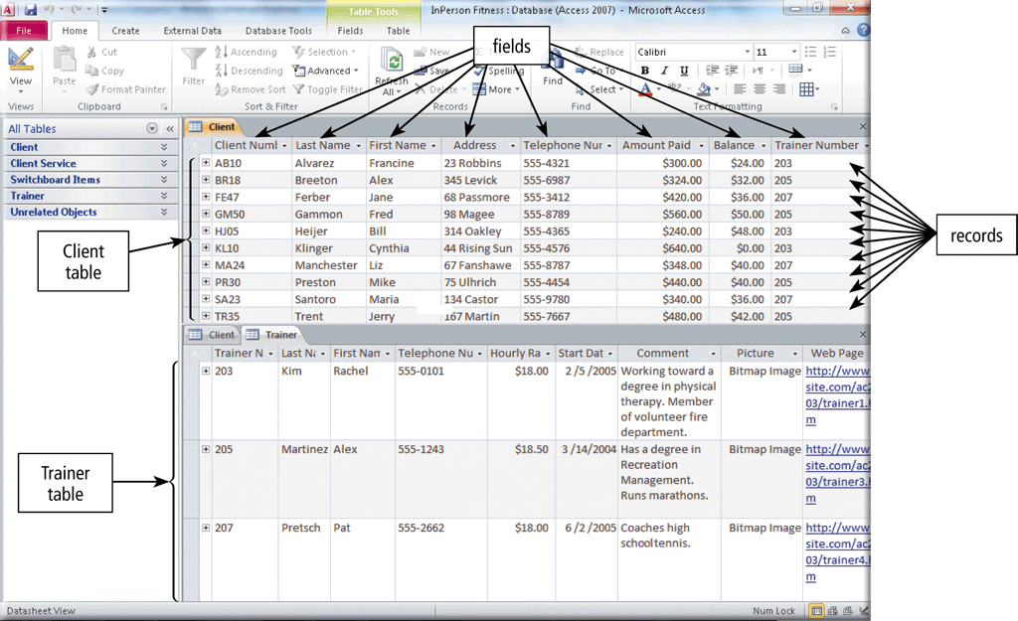
Business Software
A database is a collection of data organized in a manner that allows access, retrieval, and use of that data
Database software allows users to create, access, and manage a database
Page 153
Figure 3-11

Slide 29
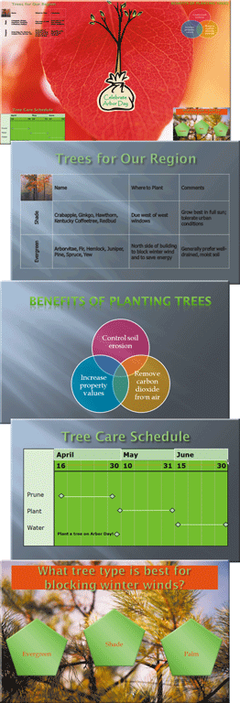
Business Software
Presentation software allows users to create visual aids for presentations to communicate ideas, messages, and other information to a group
Page 154
Figure 3-12

Slide 30
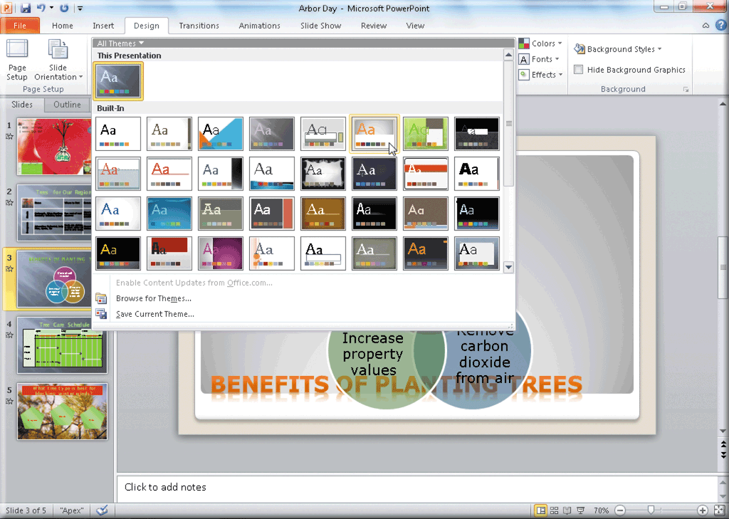
Business Software
Page 155
Figure 3-13

Slide 31
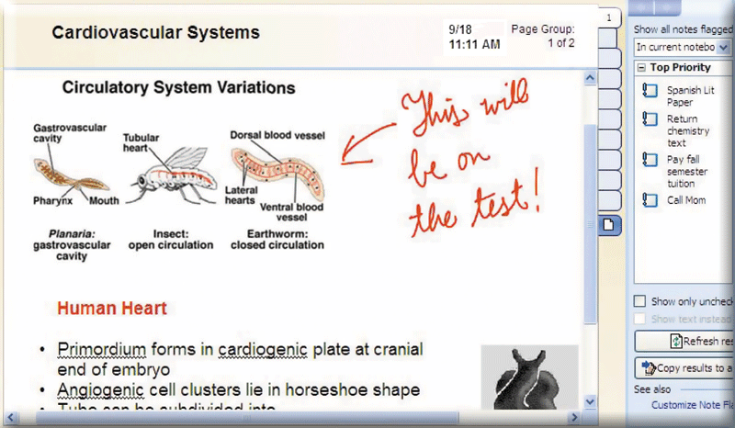
Business Software
Note taking software is application software that enables users to enter typed text, handwritten comments, drawings, or sketches anywhere on a page
Page 156
Figure 3-14

Slide 32
Business Software
A software suite is a collection of individual programs available together as a unit
A personal information manager (PIM) is application software that includes
Appointment calendar
Address book
Notepad
Page 156

Slide 33
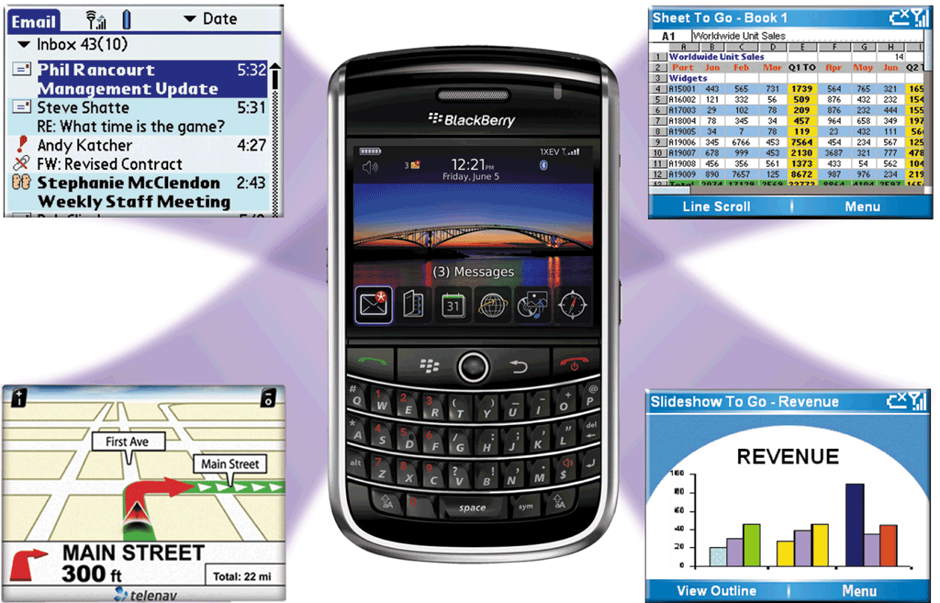
Business Software
Scaled down versions of software are available to work with smart phones and other mobile devices
Pages 156 – 157
Figure 3-15

Slide 34
Business Software
Project management software allows a user to plan, schedule, track, and analyze the events, resources, and costs of a project
Accounting software helps companies record and report their financial transactions
Document management software provides a means for sharing, distributing, and searching through documents by converting them into a format that can be viewed by any user
Pages 157 – 158
Figures 3-16 – 3-18

Slide 35
Business Software
Enterprises typically require special computing solutions for various functional units
Human resources
Accounting
Engineering
Marketing
Sales
Distribution
Customer service
Information technology
Manufacturing
Page 159

Slide 36
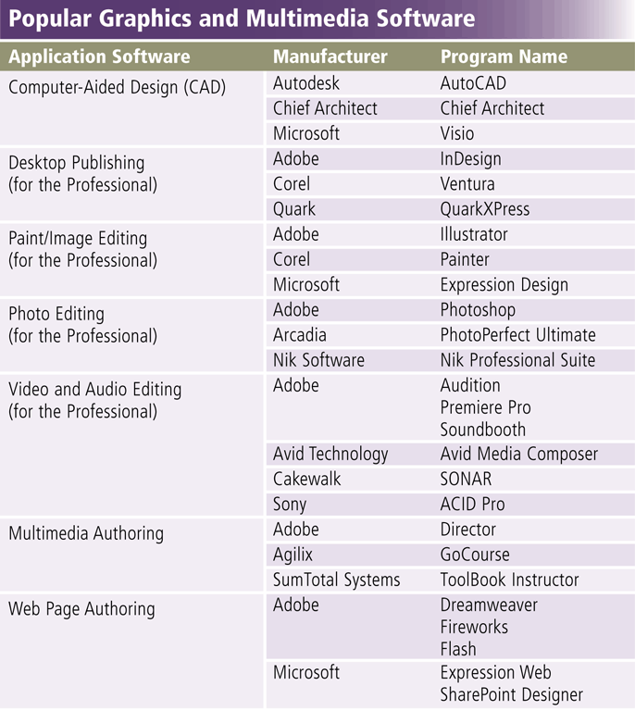
Graphics and Multimedia Software
Page 159
Figure 3-19

Slide 37
Graphics and Multimedia Software
Computer-aided design (CAD) software
Desktop publishing software
Paint/Image editing software
Pages 160 – 161
Figures 3-20 – 3-22

Slide 38
Graphics and Multimedia Software
Professional photo editing software
Video and audio editing software
Multimedia authoring software
Pages 162 – 163
Figures 3-23 – 3-25

Slide 39
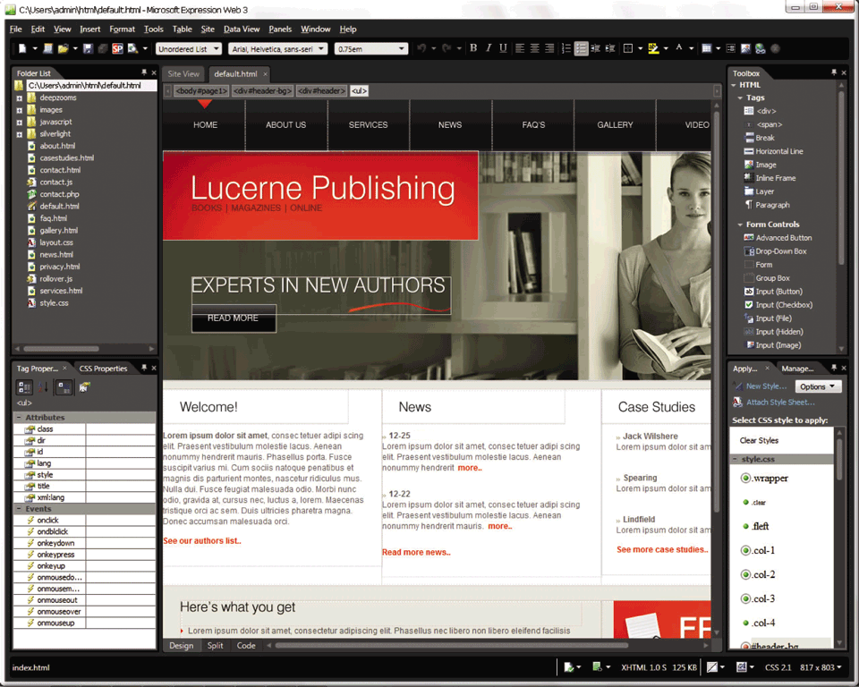
Graphics and Multimedia Software
Web page authoring software helps users of all skill levels create Web pages that include multimedia and interactive content
Page 164
Figure 3-26

Slide 40
Software for Home, Personal, and Educational Use
Personal finance software
Legal software
Tax preparation software
Pages 166 – 167
Figures 3-28 – 3-30

Slide 41
Software for Home, Personal, and Educational Use
Personal DTP software
Personal paint/image editing software
Personal photo editing software
Pages 167 – 169
Figures 3-31 – 3-33

Slide 42
Software for Home, Personal, and Educational Use
Clip art/image gallery
Video and audio editing software
Home design/landscaping software
Pages 169 – 170
Figures 3-35 – 3-37

Slide 43
Software for Home, Personal, and Educational Use
Travel and mapping software
Reference software
Educational software
Entertainment software
Pages 170 – 172
Figures 3-38 – 3-41

Slide 44
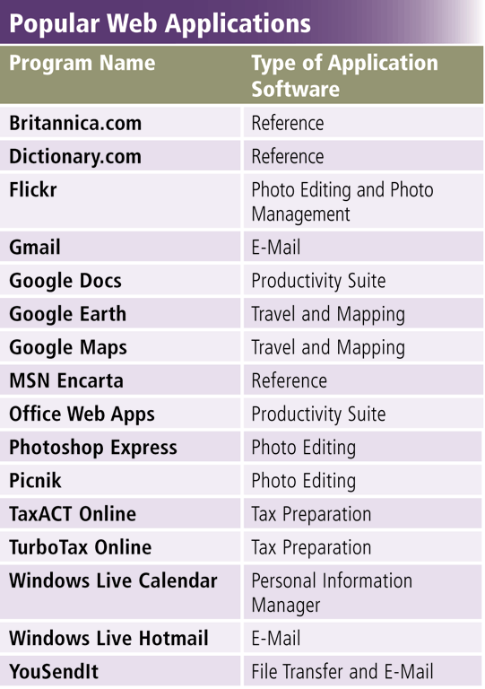
Web Applications
A Web application is a Web site that allows users to access and interact with software from any computer or device that is connected to the Internet
Pages 172 – 173
Figure 3-42

Slide 45
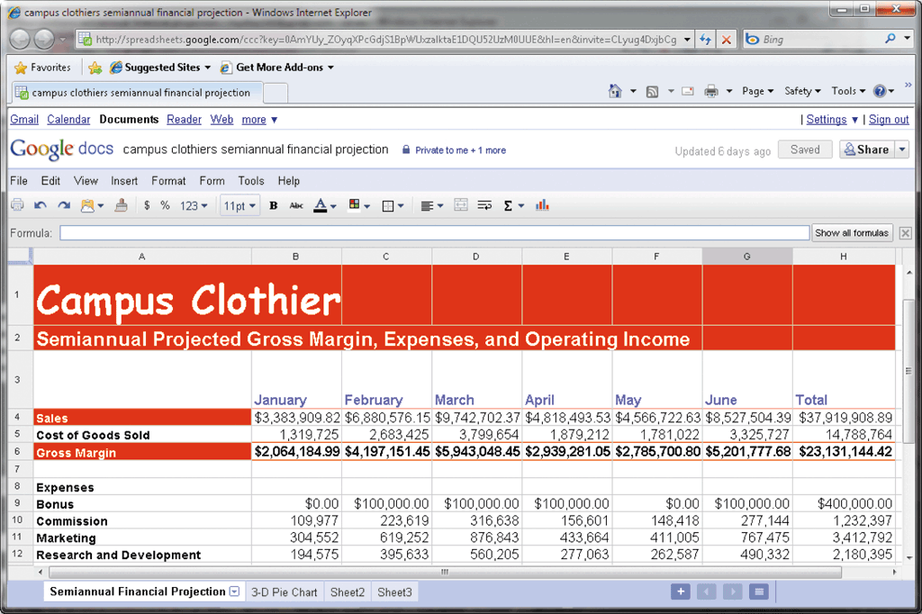
Web Applications
Page 173
Figure 3-43

Slide 46
Application Software for Communications
Web Browser
E-Mail
Instant Messaging
Chat Room
Text, Picture, Video Messaging
RSS Aggregator
Blogging
Newsgroup/Message Board
FTP
Video Conferencing
VoIP
Page 174
Figure 3-44

Slide 47
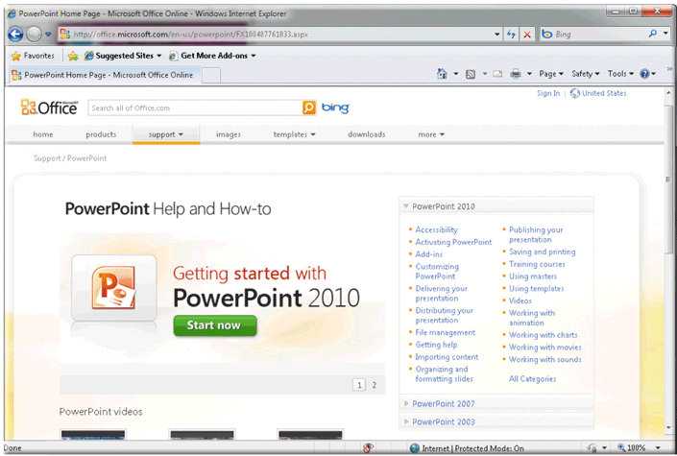
Learning Tools for Application Software
Web-based Help provides updates and more comprehensive resources to respond to technical issues about software
Page 175
Figure 3-45b

Slide 48
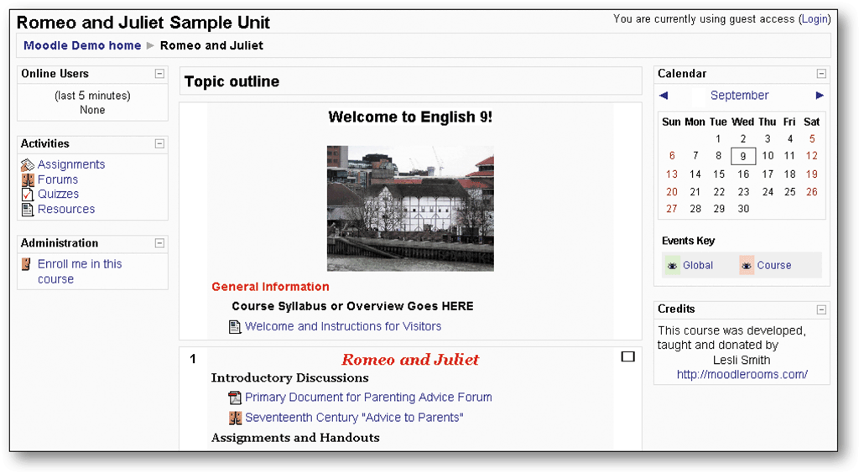
Learning Tools for Application Software
Web-based training is a type of CBT that uses Internet technology and consists of application software on the Web
Distance learning (DL) is the delivery of education at one location while the learning takes place at other locations
Page 176
Figure 3-46

